Slide 1
Analyze NYC-Flight data
By Sandeep Rathod

Slide 2
Contents
Domain & topic of project
Introduction (brief info on project)
Dataset description
Business questions
Domain & topic of project
Domain-Airlines
Project-Analyze NYC-Flight data

Slide 3
Project introduction
New York flight data set given contains flight data for year 2013. It has information of all the flights that has been departed from J.F Kennedy, Newark and La Guardia airport to local or international location. Project objective is to provide insights on delay of flights for year 2013.
Dataset description
Dataset contains information about all flights that departed from New york (e.g. EWR, JFK and LGA) in 2013: 336,776 flights in total. It contains columns such as Scheduled departure time, Departure time, Schedule arrival time, Arrival time, departure delay ,arrival delay, origin airport, destination airport , day and month of Year of flight.

Slide 4
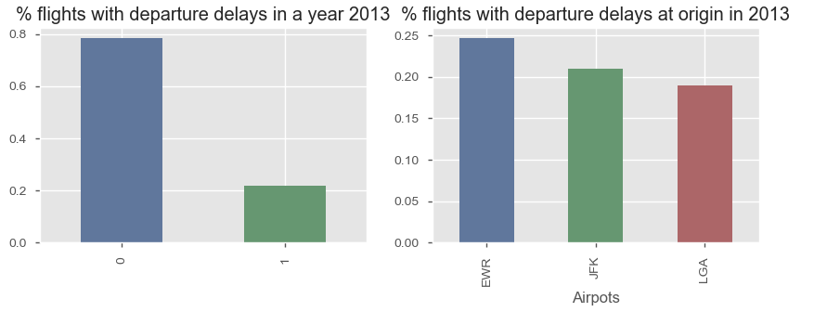
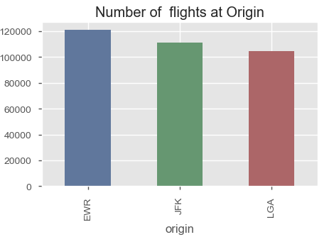
Insights on - Departure delays.
In 2013,nearly 22% of total flights departed from EWR,JFK and LGA has delayed above 15 mins. It has been observed that Newark airports has highest number of delayed flights followed by JFK and La Guardia in 2013. Percentage wise delay confirms that Newark is badly operated airport as far as delay is concerned. Nearly 25% of its flight was delay in 2013. La Guardia(LGA) airport is best airport among the three w.r.t best timely departure% as departure delay is least among the three. Total count of flight chart shows that Newark has highest departed number of flights too and so is the highest number of delay counts too.

Slide 5
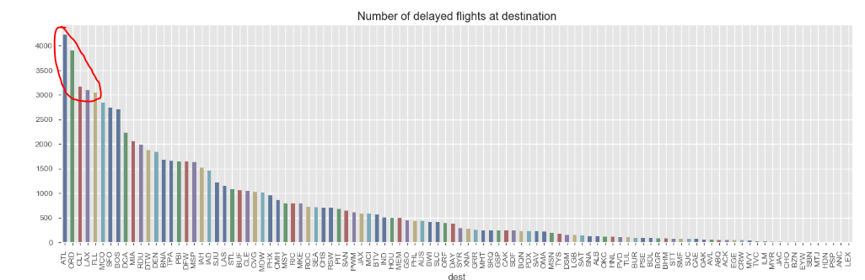
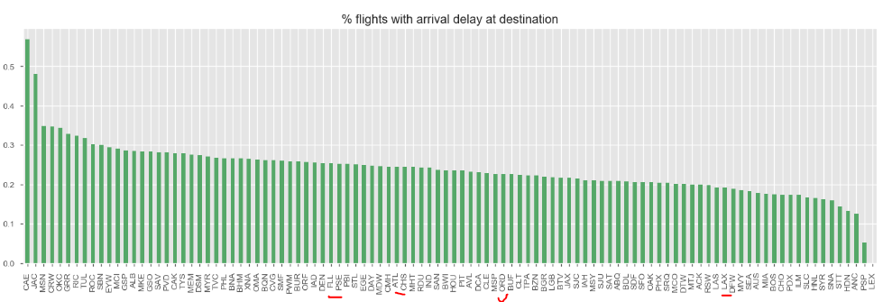
Insights on - Arrival delays.
Destination airports like Atlanta ,ORA ,CLT,LAX and FLL are among top five destination where arrival delay count is more. However, percentage of delay w.r.t total destination flights shows the actual destination where arrival delay ratio is maximum are CAC,JAC and MSN where more than 35% of arrival flights at each airport departed from EWR,JFK and LGA are delayed.

Slide 6
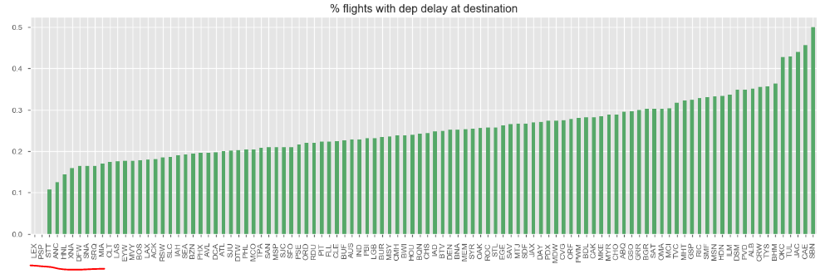
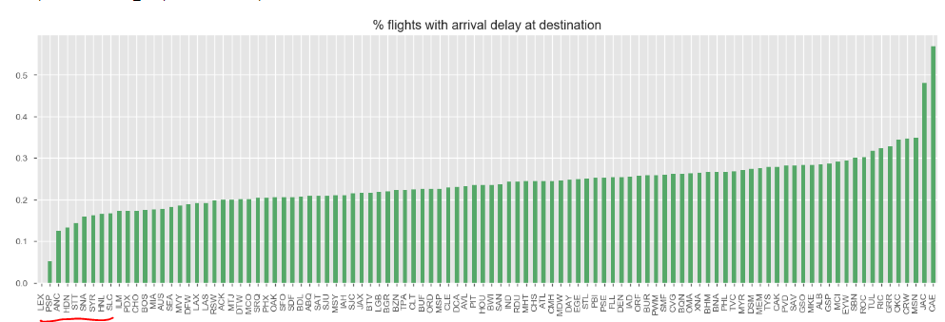
Insights on – On time arrival % analysis .
Comparing % wise departure delay of destination of flights from origin airport Vs %wise arrival delay at destination airport it is clear- Flight delay arriving at destination airport is more or less same as delay due to departure. On time % arrival of flights highly depends on departure delay. Also it means aircraft speed or type of aircraft also doesn't help to reduce the delay or improve on-time arrival percent.

Slide 7
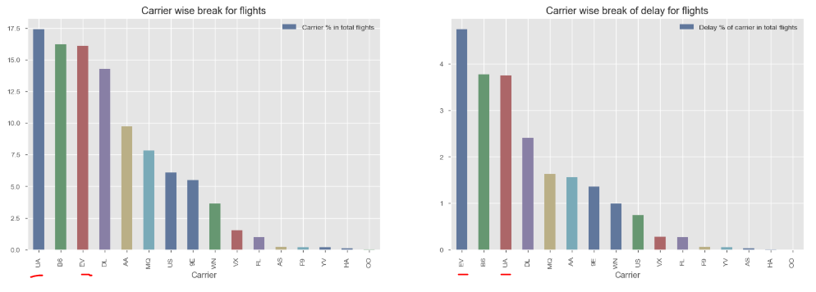
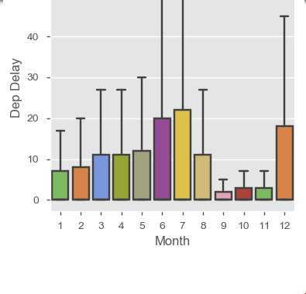
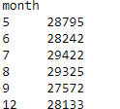
Insights on – Airlines analysis.
Chart shows that UA,B6,EV and DL shares major percent of flights to be operated from three airports of EWR,JFK and LGA .
Spot anomalies from chart states that UA airlines have done better in reducing departure delay which will require further data for exploration.
Insights on – month wise analysis
Month wise, chart reveals that delay percentage increases significantly or doubles out in June ,July and December.
However, from flight count perspective per month , in July flight count has increased by 1200 flights which is marginally and less than 1% from average operated flights per month.

Slide 8
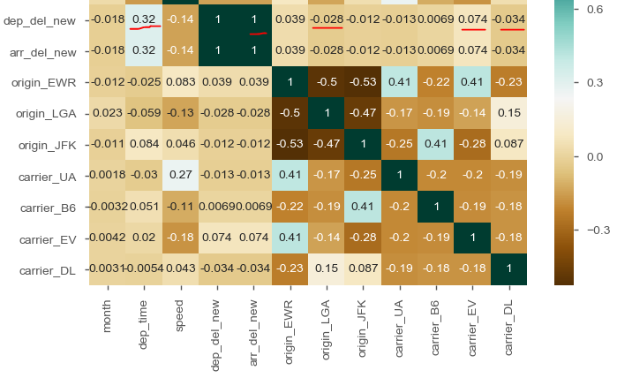
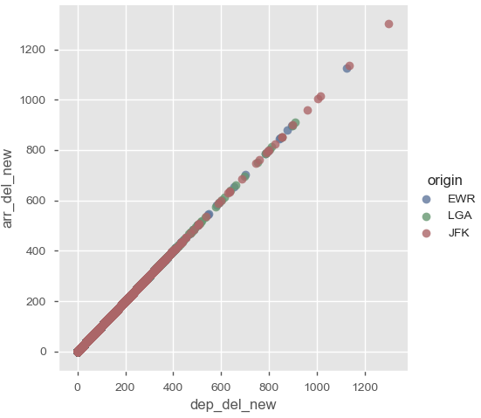
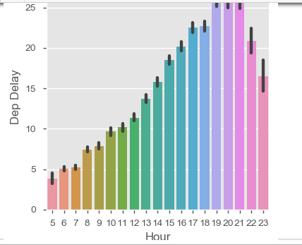
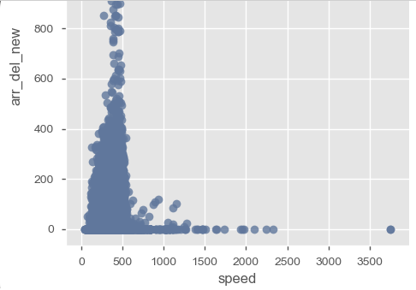
Summary
Firstly , it is very much evident that departure delay at origin airport of Newark, J F Kennedy and La-Guardia is significant. Due to the departure delay there is strong +ve co-relation of arrival delay at other receiving. Also other co-relation we can see that as departure time increases i.e from morning to afternoon and so on, there is slight increase in delay. Airport, speed and carrier also has some co-relation on departure as well as arrival delay.

Slide 9
Summary
There could be several reason why 22% flights are delayed in 2013 among which popular could Airports already running beyond it maximum operational capacity. Airports Infrastructure not designed or adequate as per terminals for hopping. Limited run-way and need for additional. Proximity of all these 3 airports which results in congestion. Staffing during June, July and December as they are major holiday season in USA.

